Slide 1
Credit Card Defaulter Prediction
Group Members:
Maliha Rahman- 15101105
Kaniz Fatema- 14301103
Md.Rezyuan- 15101114

Slide 2
Contributions of different members
1. Member 1: Abstract and Dataset analysis
2. Member 2: Algorithm Analysis and
Explanation of Library
3. Member 3: Coding and Result Analysis

Slide 3
Abstract:
Area of our work -Supervised
Specifically: Classification, Predictions
Feature selection algorithm
Real dataset of credit card consumption
Area Covered: Data Analytics
Results Experiment

Slide 4
Dataset
LIMIT_BAL: amount of the given credit (NT dollar) : It includes both the individual consumer credit and his/her family (supplementary) credit.
SEX: Gender (1=male;2=female).
EDUCATION: Education (1= graduate school; 2= university;
3= high school; 4= others)
MARRIAGE: Marital status (1= married; 2= single; 3= others)
AGE: Age (year)
BILL_AMT1-BILL_AMT6:Amount of bill statement (NT dollar) Bill_Amt1=amount of bill statement in September,2005; Bill_Amt2=amount of bill statement in August,2005….; Bill_Amt6=amount of bill statement in April,2005.

Slide 5
Dataset
PAY_0-PAY_6: History of past payment. We tracked the past monthly payment records (April-September 2005) as follows:
Pay_0 = the repayment status in Sept,2005;
Pay_1=the repayment status in August,2005,..;
Pay_5=the repayment status in April,2005.
The measurement scale for the repayment status is :
-1=pay duly;
1=payment delay for one month;
2=payment delay for two months,….;
8=payment delay for eight months and above.

Slide 6
Dataset
PAY_AMT1-PAY_AMT6: Amount of previous payment (NT dollar)
Default payment next month: positive class: default | negative class: pay

Slide 7
Library
Numpy
Matplotlib
Pandas
Sklearn

Slide 8
Accuracy - the proportion of the total number of
prediction that are correct
Precision - the proportion of the positive prediction that are actually correct
Recall - the proportion of the actual defaulters that the model will correctly predict
from sklearn.metrics import accurcy_scrore, precision_score, recall_score, confusion_matrix
Null Model: Always predict the most common category
from sklearn.prepocessing import RobustScale

Slide 9
Algorithms
K-Nearest Neighbors (KNN).
Naïve Bayes Classifier Algorithm (Gaussian)
Linear Regression
Logistic Regression
Random Forests
Decision Trees
Support Vector Machines (SVM).

Slide 10
Algorithms
Naïve Bayes Classifier Algorithm (Gaussian)
from sklearn.naive_bayes import GaussianNB
Logistic Regression-
from sklearn.linear_model importLogisticRegression
Parameter- Njobs ; random_states
Decision Trees
from sklearn.tree import DecisionTreeClassifier
Parameter- minimun number of observation;
minimun no of samples ; random_states

Slide 11
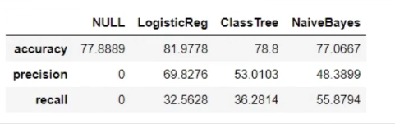
Result Analysis-1

Slide 12
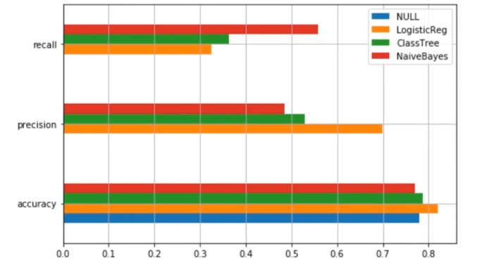
Result Analysis-2

Slide 13
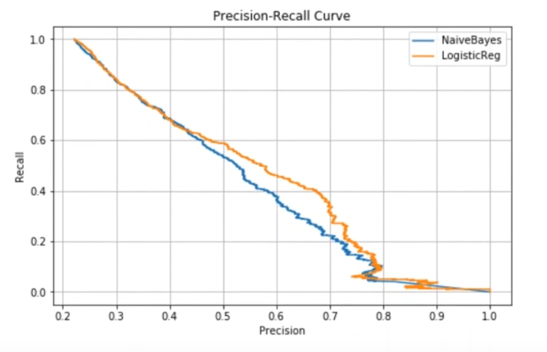
Result Analysis-3

Slide 14
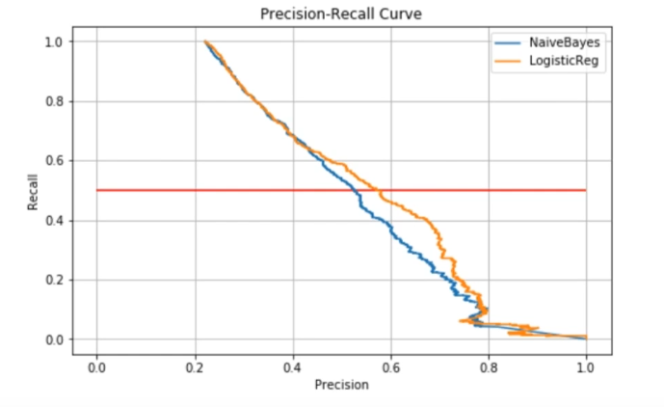
Result Analysis-4

Slide 15
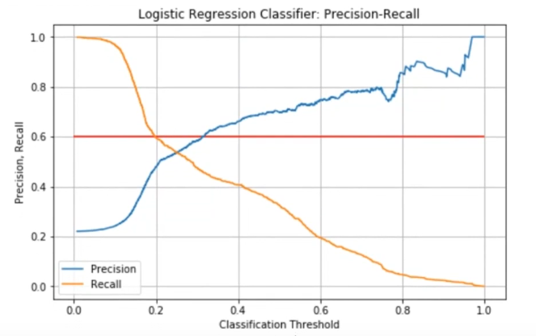
Result Analysis-5

Slide 16
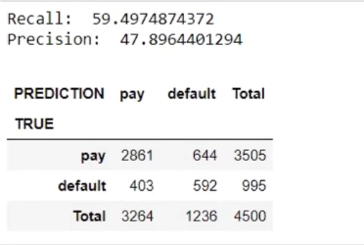
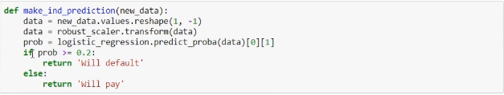
Conclusion- Expected Output

Slide 17
Reference
1.Project Idea-
https://rstudio-pubs- static.s3.amazonaws.com/209149_8de3e66249f442288ed51b07fd384c12.html#/1
2. Dataset –
https://www.kaggle.com/hitz02/credit-card-default/data
3. Where did you find the code -https://medium.com/@guaisang/credit-default-prediction-with-logistic-regression-b5bd89f2799f
4. Tutorial following- Packt Video
https://www.youtube.com/channel/UC3VydBGBl132baPCLeDspMQ

